Slide 1


Chapter 2: Network Design Fundamentals
CCNP SWITCH v7.1: Implementing Cisco IP Switched Networks

Slide 2
Chapter 2 Objectives
Hierarchical Network Design
The Cisco Enterprise Campus Architecture
Comparing Layer 2 and Multilayer Switches
Cisco Switching Methods

Slide 3

Campus Network Structure

Slide 4
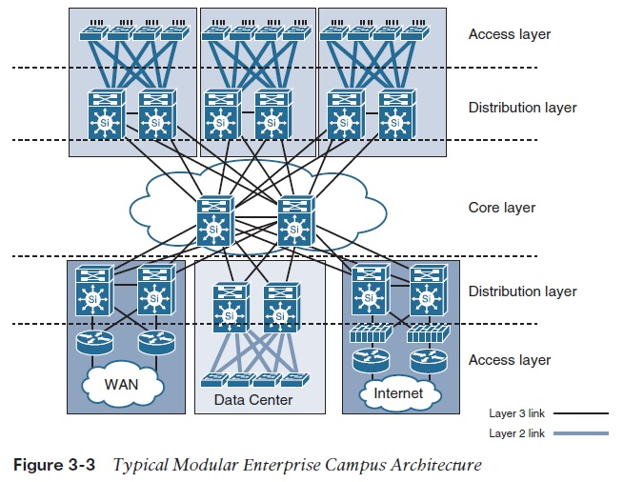
Campus Network Structure
A campus network describes the portion of an enterprise infrastructure that interconnects end devices such as computers, laptops, and wireless access points to services such as intranet resources or the Internet
Prior to the mid 2000’s campus networks also included application server farms and computing infrastructure as well.
Today , the infrastructure that interconnects server farms, application servers, and computing nodes are clearly distinguished from campus networks, and are referred to as data centres

Slide 5
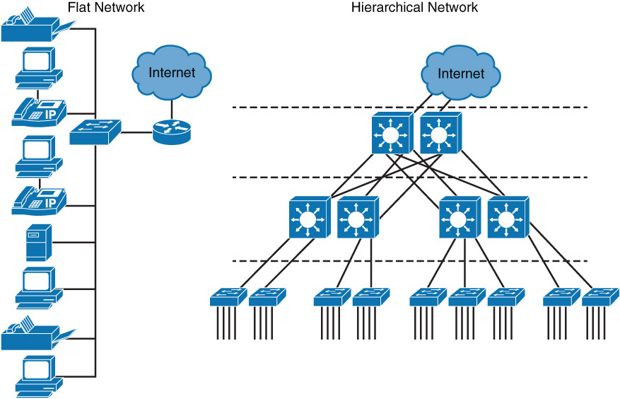
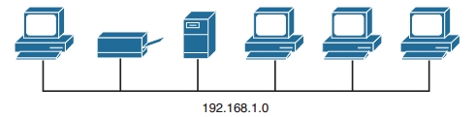
Flat Network vs Hierarchical Network Design

Slide 6
Flat Network Design
All PCs, servers, and printers are connected to each other using Layer 2 switches
Does not use subnets for any design purposes.
All devices are in the same broadcast domain, and broadcasts will be flooded to all attached network devices
In a network size of 10 devices, this is not an issue
In a network of 1000s of devices, this becomes a major issue
Hence does not scale, and thus a hierarchical model is used.

Slide 7
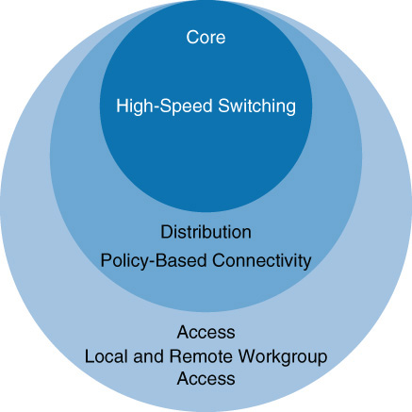
The Hierarchical Model
Hierarchical models for network design allow network to be designed in layers.
Simplifies campus network design by allowing focus at different layers that build on each other.
The layers are divided into specific functions of categorized as core, distribution and access layers.
This categorization provides for modular and flexible design, with the ability to grow and scale the design without major modifications or reworks

Slide 8
The Hierarchical Model - Characteristics
Access Layer
Used to grant the user access to network applications and functions
In a campus network, generally incorporates switched LAN devices with ports that provide connectivity to workstations, IP phones, access points and printers
Distribution Layer
Aggregates the access layer switches wiring closets, floors, or other physical domain by leveraging module or Layer 3 switches.
Core Layer (also referred to as the backbone)
High speed backbone which is designed to switch packets as fast as possible. In most campus networks, the core layer has routing capabilities.
Must provide a high level of availability and adapt to changes quickly
Provides dynamic scaling to accommodate growth and fast convergence in the event of a failure.

Slide 9
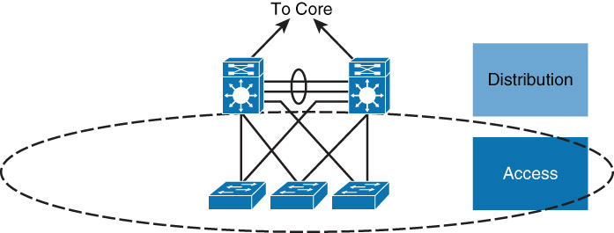
Access Layer
Access switches usually provide Layer 2 (VLAN) connectivity between users.
Devices in this layer, sometimes called building access switches, should have the following capabilities:
Low cost per switch port
High port density
Scalable uplinks to higher layers
High availability
Ability to converge network services (that is, data, voice, video)
Security features and quality of service (QoS)

Slide 10
Access Layer Capabilities
High availability
The access layer supports high availability via default gateway redundancy using dual connections from access switches to redundant distribution layer switches when there is no routing in the access layer. This mechanism behind default gateway redundancy is referred to as first-hop redundancy protocol (FHRP).
Convergence
The access layer generally supports inline Power over Ethernet (PoE) for IP telephony, thin clients, and wireless access points (APs).
In addition, the access layers allow support for converged features that enable optimal software configuration of IP phones and wireless APs, as well.
Security
The access layer also provides services for additional security against unauthorized access to the network by using tools such as port security, quality of service (QoS), Dynamic Host Configuration Protocol (DHCP) snooping, dynamic ARP inspection (DAI), and IP Source Guard.

Slide 11
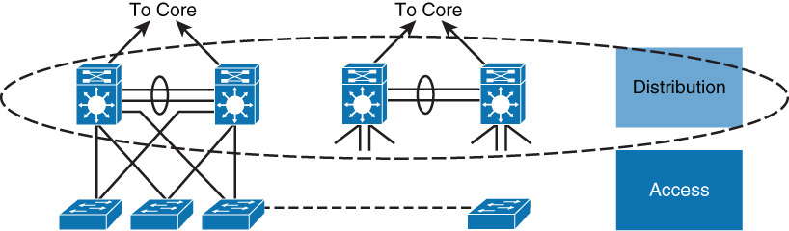
Distribution Layer
Has a unique role in which it acts as a services and control boundary between the access layer and the core.
Availability, fast path recovery, load balancing, and QoS are all important considerations at the distribution layer.
Generally, high availability is provided through Layer 3 redundant paths from the distribution layer to the core, and either Layer 2 or Layer 3 redundant paths from the access layer to the distribution layer.

Slide 12
Distribution Layer
With a Layer 2 design in the access layer, the distribution layer generally serves as a routing boundary between the access and core layer by terminating VLANs.
The distribution layer may perform tasks such as controlled routing decision making and filtering to implement policy-based connectivity, security, and QoS.
These features allow for tighter control of traffic through the campus network.
To improve routing protocol performance further, the distribution layer is generally designed to summarize routes from the access layer.
In addition, the distribution layer optionally provides default gateway redundancy by using a first-hop routing protocol (FHRP) such as HSRP, GLBP, or VRRP.

Slide 13
Distribution Layer Functions
Provides high availability and equal-cost load sharing by interconnecting the core and access layer via at least dual paths
Generally terminates a Layer 2 domain of a VLAN
Routes traffic from terminated VLANs to other VLANs and to the core
Summarizes access layer routes
Implements policy-based connectivity such as traffic filtering, QoS, and security
Provides for an FHRP

Slide 14
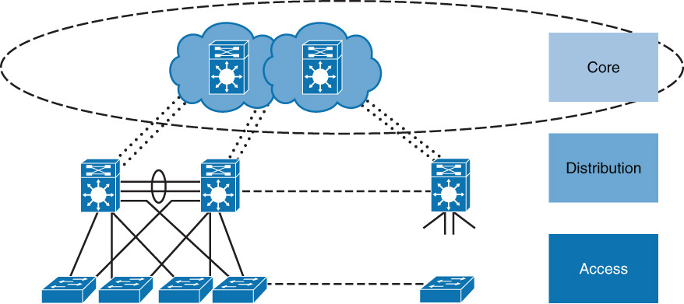
Core Layer (Backbone)
From a design point-of-view, the campus core is in some ways the simplest yet most critical part of the campus.
It provides a limited set of services and is designed to be highly available and requires 100 percent uptime.
In large enterprises, the core of the network must operate as a nonstop, always-available service.

Slide 15
Core Layer (Backbone)
The key design objectives for the campus core are based on providing the appropriate level of redundancy to allow for near-immediate data-flow recovery in the event of the failure of any component (switch, supervisor, line card, or fiber interconnect, power, and so on).
The network design must also permit the occasional, but necessary, hardware and software upgrade or change to be made without disrupting any network applications.
The core of the network should not implement any complex policy services, nor should it have any directly attached user or server connections.
The core should also have the minimal control plane configuration that is combined with highly available devices that are configured with the correct amount of physical redundancy to provide for this nonstop service capability.

Slide 16
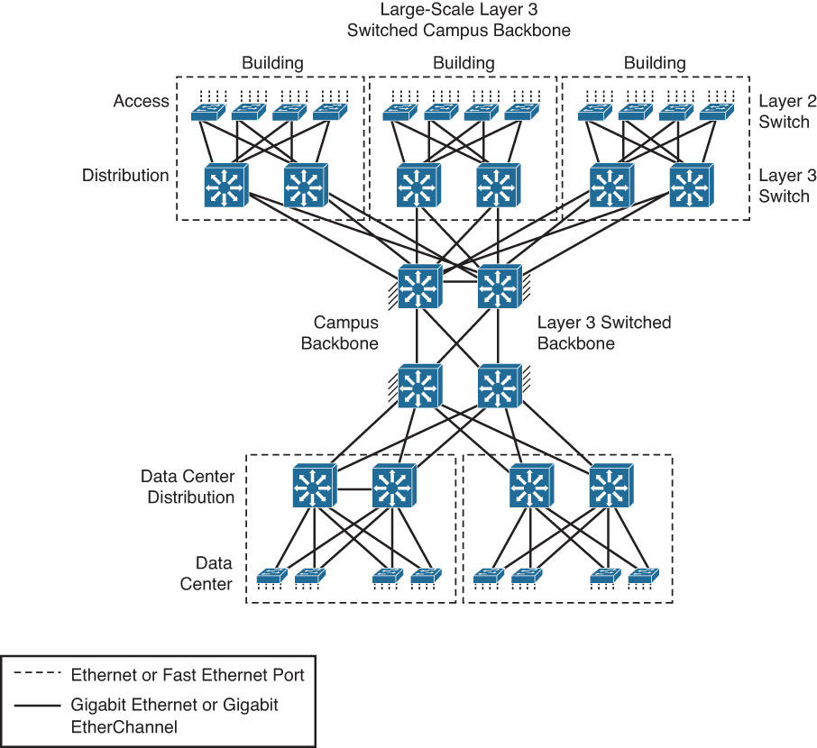
Core Layer – Large Campus Network
From an enterprise architecture point-of-view, the campus core is the backbone that binds together all the elements of the campus architecture to include the WAN, the data center, and so on.
In other words, the core layer is the part of the network that provides for connectivity between end devices, computing, and data storage services that are located within the data center, in addition to other areas and services within the network.

Slide 17
Core Layer Functions
Aggregates the campus networks and provides interconnectivity to the data center, the WAN, and other remote networks
Requires high availability, resiliency, and the ability to make software and hardware upgrades without interruption
Designed without direct connectivity to servers, PCs, access points, and so on
Requires core routing capability
Architected for future growth and scalability
Leverages Cisco platforms that support hardware redundancy such as the Catalyst 4500 and Catalyst 6800

Slide 18
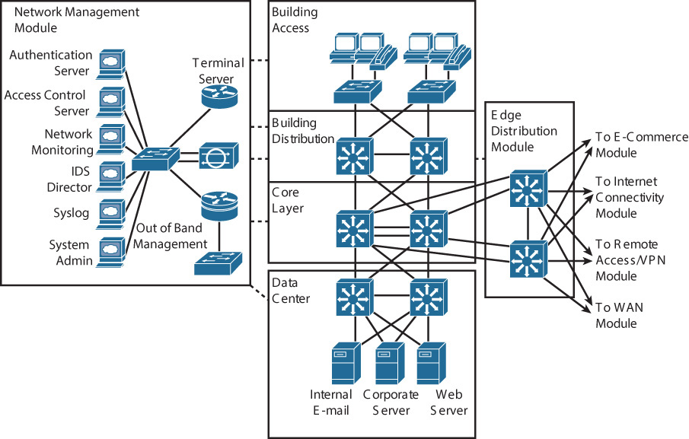
Core Layer Interconnecting with the Enterprise Network

Slide 19
Review Questions
1. Which of the following statements is true about campus networks?
a. The campus network describes the interconnections of servers in a data center.
b. The campus network describes the WAN interconnectivity between two remote sites and head office.
c. The campus network describes the network devices that interconnect end users to applications such as e-mail, the intranet, or the Internet over wire or wireless connections.
2. Which of the following is a disadvantage to using flat Layer 2 networks?
a. Broadcast packets are flooded to every device in the network.
b. No IP boundary to administer IP-based access control.
c. A host flooding traffic onto the network effects every device.
d. Scalability is limited.
e. All the above

Slide 20
Review Questions
3. Why are networks designed with layers?
a. Allows focus within specific layers due to grouping, segmentation, and compartmentalization
b. Simplification of network design
c. Optimizes use of physical interconnects (links)
d. Optimizes application of policies and access control
e. Eases network management
f. All of the above
4. Identify the three layers of the hierarchical model for designing networks.
a. Core
b. Access
c. Distribution
d. Enterprise edge
e. WAN
f. Wireless

Slide 21
Review Questions
5. Match each layer to its definition.
a. Core
b. Distribution
c. Access
1. Connects PCs, wireless access points, and IP phones
2. High-speed interconnectivity layer that generally supports routing capability
3. Aggregates access layer switches and provides for policy control
6. Which of the following are generally true about recommended core layer designs?
a. Requires high-availability and resiliency
b. Connects critical application servers directly for optimal latency and bandwidth
c. Leverages fixed form factor switches in large enterprises

Slide 22
Layer 3 in the Access Layer
Benefits
Using a design that leverages Layer 3 switching to the access layer VLANs scales better than Layer 2 switching designs because VLANs get terminated on the access layer devices.
The links between the distribution and access layer switches are routed links; all access and distribution devices would participate in the routing scheme.
The Layer 2-only access design is a traditional, slightly cheaper solution, but it suffers from optimal use of links between access and distribution due to spanning tree
Drawbacks
Layer 3 designs introduce the challenge of how to separate traffic.
Layer 3 designs also require careful planning with respect to IP addressing.
A VLAN on one Layer 3 access device cannot be on another access layer switch in a different part of your network because each VLAN is globally significant.
Traditionally, mobility of devices is limited in the campus network of the enterprise in Layer 3 access layer networks. without using an advanced mobility networking features .

Slide 23
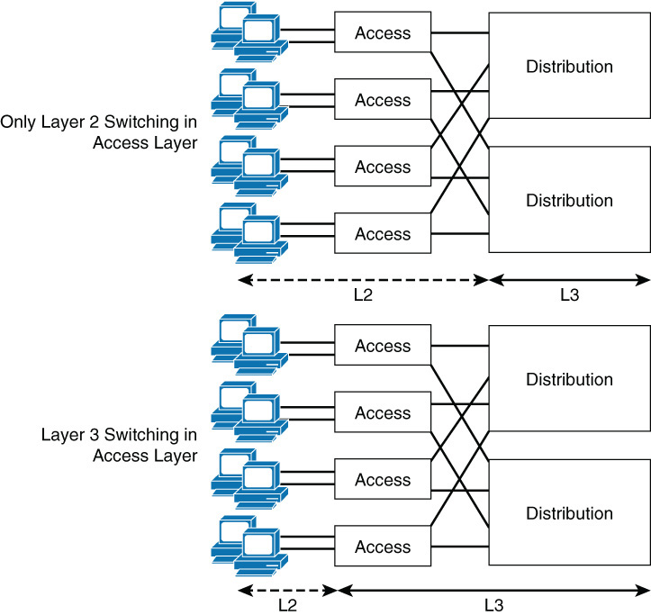
Layer 3 in the Access Layer
Because of the reduced cost and a few inherit benefits, Layer 3 switching in the access layer has become more common over typical Layer 2 switching in the access layer.
Using Layer 3 switching or traditional Layer 2 switching in the access layer has benefits and drawbacks.

Slide 24
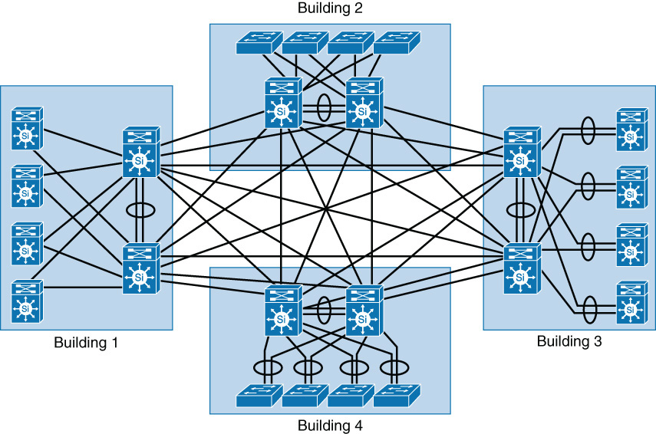
The Collapsed Core
The three physical tiers of switches is not a strict requirement
In a smaller campus, the two tiers of core and distribution can be combined into one physical switch: a collapsed distribution and core
This however requires a fully meshed network between each building as shown below

Slide 25
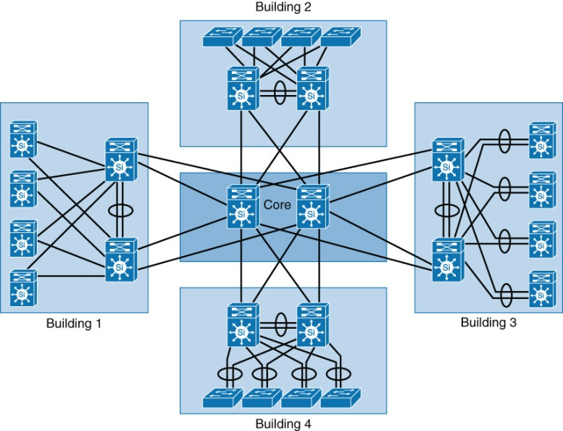
The need for a Core Layer
Despite a possible lower initial cost to build, the collapsed core is difficult to scale
Each new building require full-mesh connectivity to all distribution switches
The routing complexity also increases due to the number of routing peers
With the 4 buildings shown previously, a total of 28 links was required between the distribution switches. n(n-1)/2
A dedicated core layer allows growth without requiring full mesh connectivity between the distribution switches

Slide 26

Types of Cisco Switches

Slide 27
Types of Cisco Switches
Cisco designs the Catalyst switches for campus networks and Nexus switches for data centers. The context of CCNP will focus mostly on Catalyst switches.

Slide 28
Comparing Layer 2 and Multilayer Switches
L2 switches make decisions about forwarding frames based on the destination MAC addresses found within the frame.
When a switch receives in store-n-forward mode, the frame is checked for errors, and frames with a valid cyclic redundancy check (CRC) are regenerated and transmitted.
Some models of switches, mostly Nexus switches, opt to switch frames based only on reading the Layer 2 information and bypassing the CRC check.
This bypass, referred to as cut-through switching, lowers the latency of the frame transmission as the entire frame is not stored before transmission to another port.
Lower switching latency is beneficial for low-latency applications such as algorithm trading programs found in the data center. The assumption is that the end device network interface card (NIC) or an upper-level protocol will eventually discard the bad frame.
Most Catalyst switches are store-n-forward.
Notes:
Recalling basic networking: A switch collision domain is only port to port because each switch port and its associated end device is its own collision domain. Because there is no contention on the media, all hosts can operate in full-duplex mode, which means that they can receive and transmit data at the same time.
The concept of half duplex is legacy and applies only to hubs and older 10/100-Mbps switches, because 1 Gbps operates by default at full duplex.

Slide 29
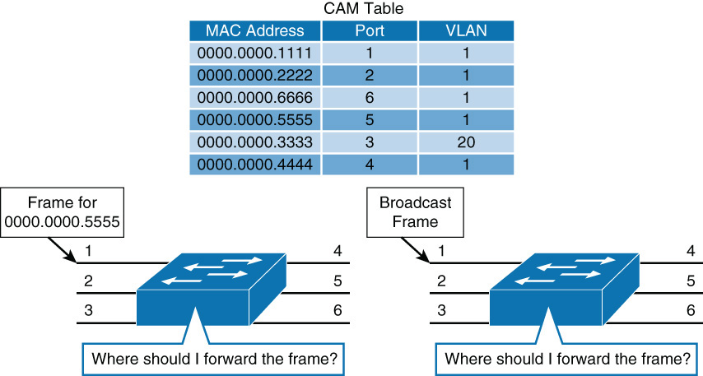
MAC Address Forwarding
Given the information below, where should these two frames be forwarded
The switch must look up its MAC address table
What happens if the destination MAC address of the frame is unknown?
The switch uses unknown unicast flooding
The switch forwards the frame through all ports within the VLAN except the port the frame was received on

Slide 30
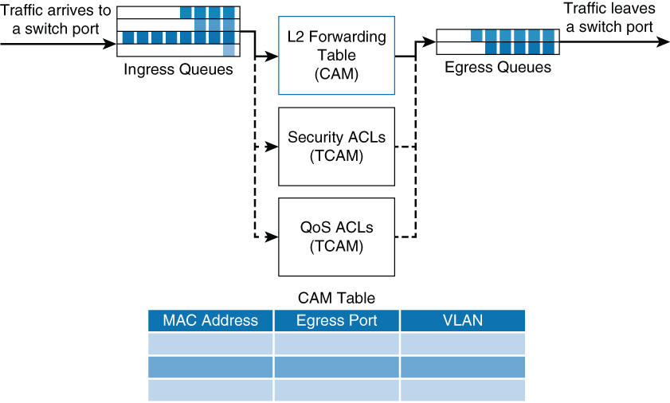
Layer 2 Switch Operation
When a switch receives a frame it places the frame into an ingress queue
The switch needs to answer some questions:
Where should the frame be forwarded?
Are there restrictions preventing the forwarding of the frame?
Is there any prioritization or marking that needs to be applied to the frame?

Slide 31
Layer 2 Switch Operation
Layer 2 forwarding table: is decided by the MAC table
ACLs: do not only apply to routers. Higher-end switches support ACLs based on both MAC and IP addresses, whereas Layer 2 switches support only ACLs with MAC addresses
QoS: incoming frames can be classified according to QoS parameters. Traffic can then be marked, prioritized, or rate-limited
For the MAC table, switches use content-addressable memory (CAM), whereas the ACL and QoS tables are housed in ternary content-addressable memory (TCAM)
CAM only supports two results: 0 or 1, hence useful for Layer 2 forwarding tables.

Slide 32
Ternary Content-addressable Memory (TCAM)
TCAM provides for three results: 0, 1, and don’t care. TCAM is useful for building tables that search on longest matches, such as IP routing tables.
With a TCAM, a packet can be evaluated against an entire access list within a single table lookup
TCAM entries are composed of Value, Mask, and Result (VMR) combinations
Fields from frame or packet headers are fed into the TCAM, where they are matched against the value and mask pairs to yield a result
Most switches have multiple TCAMs so that both inbound and outbound security and QoS ACLs can be evaluated simultaneously, or entirely in parallel with a Layer 2 or Layer 3 forwarding decision

Slide 33
Layer 3 (Multilayer) Switch Operation
Multilayer switches not only perform Layer 2 switching but also forward frames based on Layer 3 and 4 information
Multilayer switches apply the same behavior as a Layer 2 switch but add an additional parallel lookup on how to route a packet.
The associated table for Layer 3 lookups is called a Forwarding Information Base (FIB) table
The FIB table not only contains egress ports and VLAN information, but also MAC rewrite information
The ACL and QoS parallel lookups happen the same as in Layer 2 switches, except there may be additional support Layer 3 ACLs and QoS prioritization
An example is a Layer 2 switch may only be able to rate-limit frames based on source or destination MAC addresses, whereas a MLS switch can rate-limit on IP/MAC addresses

Slide 34
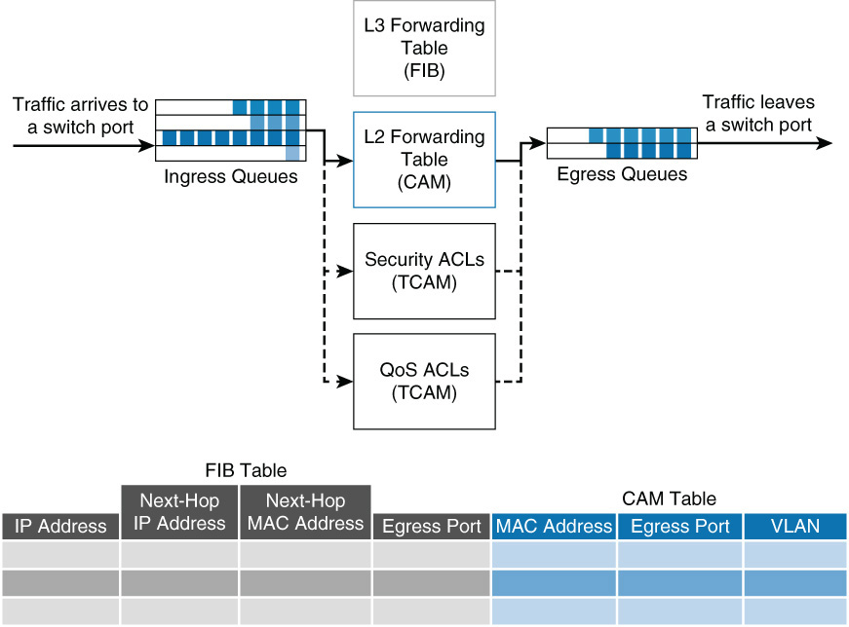
Multilayer Switch Operation

Slide 35
Commands for Viewing MAC Address Tables
There is one command for viewing the Layer 2 forwarding table on Catalyst switches: show mac address-table
The full command options are as follows:
show mac-address-table [aging-time | count | dynamic | static] [ address bw-addr] [interface interface-id] [vlan vlan-id] [ | {begin | exclude | include} expression]
Switch# show mac-address-table interface GigabitEthernet 0/1 vlan 1
Mac Address Table
------------------------------------------
Vlan Mac Address Type Ports
---- ----------- ---- -----
1 0008.2199.2bc1 DYNAMIC Gi0/1
Total Mac Addresses for this criterion: 1

Slide 36
Review Questions
7. Which of the following are benefits to using Layer 3 in the access layer? (Choose two.)
a. Reduced cost
b. Reduced Layer 2 domain
c. Reduced spanning-tree domain
d. Mobility
8. Which of the following is the biggest disadvantage with using Layer 3 in the access layer using current technologies?
a. More difficult troubleshooting
b. Lack of broadcast forwarding
c. Native mobility without additional features
d. Lack of high availability

Slide 37
Review Questions
9. A Layer 2-only switch makes forwarding decisions based on what?
a. Source MAC address
b. Destination MAC address
c. Source IP address
d. Destination IP address
10. What does a switch do when it does not know how to forward a frame?
a. Drops the frame
b. Floods the frames on all ports in the same Layer 2 domain except the source port
c. Stores the frame for later transmission
d. Resends the frame out the port where it was received

Slide 38
Review questions
11. The Layer 2 forwarding table of Cisco switches is also referred to as which of the following?
a. CAM table
b. Routing table
c. MAC address table
d. FIB table
12. Which of the following lookups does a Layer 2-only Cisco Catalyst switch perform on an ingress frame?
a. Layer 2 forwarding for destination port
b. ACL for access control
c. NetFlow for statistics monitoring
d. QoS for classification, marking, or policing

Slide 39
Forwarding Information Base (FIB)
Derived from the IP routing table.
Arranged for maximum lookup throughput.
IP destination prefixes stored in TCAM, from most-specific to least-specific entry.
FIB lookup based on Layer 3 destination address prefix (longest match) – matches structure of CEF entries within the TCAM.
When TCAM full, wildcard entry redirects frames to the Layer 3 engine.
Updated after each network change but only once. Each change in the IP routing table triggers a similar change in the FIB.
Contains all known routes. Contains all next-hop addresses associated with all destination networks.

Slide 40
Planes of Operation
Network devices contain at least three planes of operation:
Management plane
Control plane
Forwarding or data plane
Management plane is responsible for network management, such as SSH access and SNMP, and may operate over an out-of-band (OOB) port
Control plane is responsible for protocols and routing decisions
Forwarding plane is responsible for the actual routing (or switching) of most packets

Slide 41
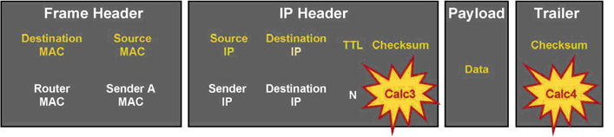
Frame Rewrite
The incoming frame checksum is verified to ensure that no frame corruption or alteration occurs during transit.
The incoming IP header checksum is verified to ensure that no packet corruption or alteration occurs during transit.

Slide 42
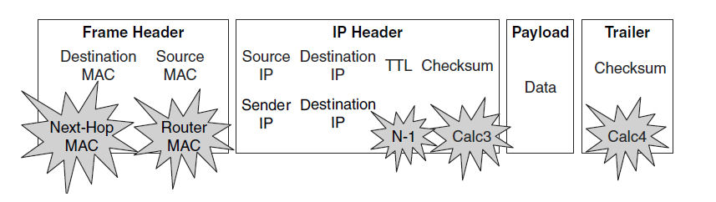
IP Unicast Packet Rewrite on Output Interface
The source MAC address changes from the sender MAC address to the outgoing router MAC address.
The destination MAC address changes from the MAC address of the router’s incoming interface to the MAC address of the next-hop router’s receiving interface.
The TTL is decremented by one, and as a result, the IP header checksum is recalculated.
The frame checksum is recalculated.
Notes:
The switch obtains the information needed for the frame rewriting process from internal tables such as CAM and TCAM tables. Some of these tables are cached in ASICs or RAM. These tables are covered in the following subsections.

Slide 43
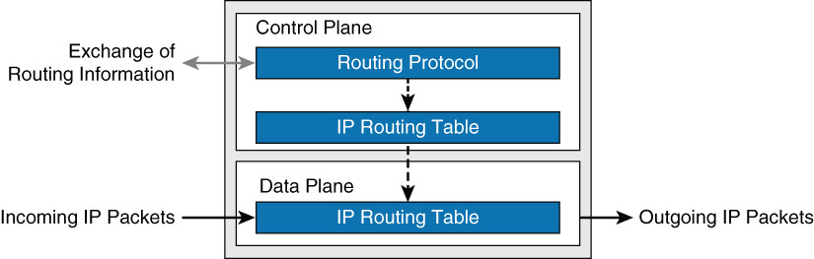
Distributed Hardware Forwarding
Multilayer switches deploy independent control and forwarding planes.
Multilayer switches may also employ multiple forwarding planes.
For example, Catalyst 6800 used forwarding planes on each line module, with a central control plane on the supervisor module

Slide 44
Cisco Forwarding Decision Methods
Route caching: Also known as flow-based or demand-based switching, a Layer 3 route cache is built within hardware functions as the switch sees traffic flow into the switch. This is functionally equivalent to Fast Switching in the Cisco router IOS.
Topology-based switching: Information from the routing table is used to populate the route cache, regardless of traffic flow. The populated route cache is called the FIB. CEF is the facility that builds the FIB. This is functionally equivalent to CEF in the Cisco router IOS.

Slide 45
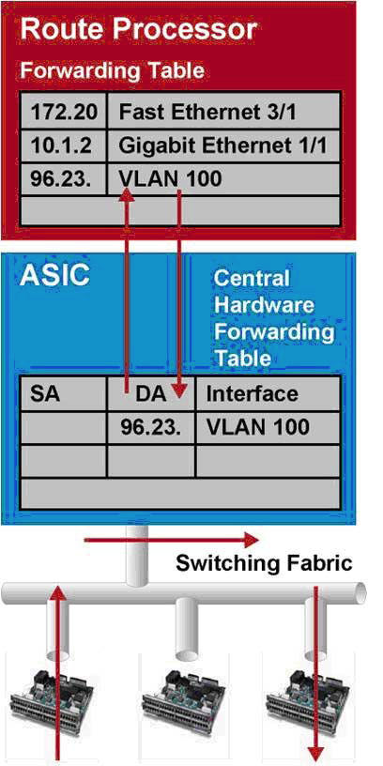
Route Caching
First packet in a stream is switched in software by the route processor.
Information is stored in cache table as a flow.
All subsequent packets are switched in hardware.
Notes:
For route caching to function, the destination MAC address of an incoming frame must be that of a switch interface with Layer 3 capability, either an SVI or routed interface.
The first packet in a stream is switched in software by the route processor because no cache entry exists yet for the new flow. The forwarding decision that is made by the route processor is then programmed into a cache table (the hardware forwarding table), and all subsequent packets in the flow are switched in the hardware. Entries are only created in the hardware-forwarding table as the switch sees new traffic flows and will time out after they have been unused for a period of time.
As shown in the figure, when the host sends its first packet the traffic goes through the router processor and then the route processor fills up the cache. Because entries are created only in the hardware cache as flows are seen by the switch, route caching always forwards at least one packet in a flow using software, which is “slow” by comparison to CEF-based forwarding in which the routing table are already loaded in hardware.

Slide 46
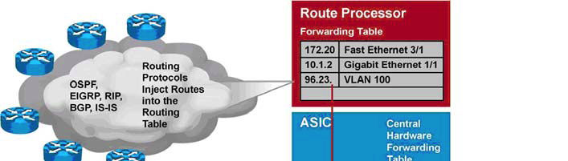
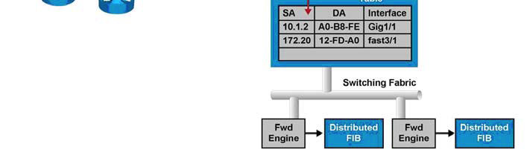
Topology-Based Switching
Faster than route caching. Even first packet forwarded by hardware.
CEF populates FIB with information from routing table.
Notes:
Layer 3 switching using topology-based switching is even faster than route caching. CEF uses information in the routing table to populate a route cache (known as a Forwarding Information Base [FIB]) without traffic flows being necessary to initiate the caching process. Because this hardware FIB exists regardless of traffic flow, assuming a destination address has a route in the routing table, all packets that are part of a flow, even the first, will be forwarded by the hardware, as shown in the figure. Because of this increased performance, topology-based switching is currently the predominate method of switching versus route caching.

Slide 47
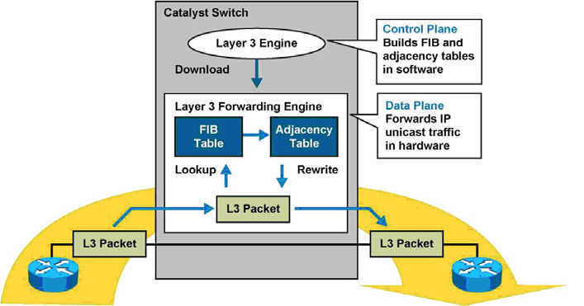
CEF Processing
CEF uses special strategies to switch data packets to their destinations expediently. It caches the information generated by the Layer 3 routing engine even before the switch encounters any data flows.
CEF caches routing information in one table (FIB) and caches Layer 2 next-hop addresses and frame header rewrite information for all FIB entries in another table, called the adjacency table (AT).

Slide 48
Adjacency Table (AT)
Derived from ARP table and contains Layer 2 header rewrite (MAC) information for each next hop contained in the FIB. Nodes in network are said to be adjacent if they are within a single hop from each other.
Maintains Layer 2 next-hop addresses and link-layer header information for all FIB entries.
Populated as adjacencies are discovered.
Each time adjacency entry created (such as via ARP), a Layer 2 header for that adjacent node is pre-computed and stored in the adjacency table.
When the adjacency table is full, a CEF TCAM entry points to the Layer 3 engine to redirect the adjacency.
Notes:
Adjacency (rewrite) information and statistics are maintained by specialized components.
CEF maintains one-to-one CEF-to-adjacency mappings for accurate statistics tracking.

Slide 49
Packet Types Forcing Software Processing
Use of IP header options (packets that use TCP header options are switched in hardware because they do not affect the forwarding decision).
Have an expiring IP TTL counter
Forwarded to a tunnel interface
Arrive with non-supported encapsulation types
Routed to interface with non-supported encapsulation type
Exceed the maximum transmission unit (MTU) of an output interface and must be fragmented
Network Address Translation (NAT)
Notes:
Not all packets can be processed in the hardware. When traffic cannot be processed in the hardware, it must receive software processing by the Layer 3 engine. This traffic does not receive the benefit of expedited hardware-based forwarding. A number of different packet types might force the Layer 3 engine to process them.
Some Cisco switches actually use different hardware to control the different planes. For example, the Cisco Catalyst 6500 is a modular switch that uses the Multilayer Switch Feature Card (MSFC) for control-plane operations, and the supervisor Policy Feature Card (PFC) for the data-plane operations.

Slide 50
CEF Load Sharing
Up to 6 adjacencies for a single FIB entry on a Catalyst 6500 – for load sharing per destination.
CEF selects a particular adjacency based on the hash of the following packet characteristics (default varies with Catalyst switch families):
Source IP address
Destination IP address
Source and destination IP Layer 4 ports
Because CEF by default would always select the same path for a given host pair, CEF “polarizes” the traffic. CEF polarization decreases as the number of host-pairs increase. In smaller networks, CEF tuning may be needed.
Notes:
CEF does support load sharing (equal-cost or unequal-cost). However, CEF does not support all the load-sharing features found in software-based CEF. With the current version of software on a Catalyst 6500 switch, a single FIB entry may have up to six adjacencies for load sharing per destination. To achieve evenly distributed load balancing across multiple interfaces, CEF selects a particular adjacency based on the hash (mathematical equivalent) of the following packet characteristics:
Source IP address
Destination IP address
Source and destination IP Layer 4 ports
In addition, parallel paths can exist and enable CEF to perform load balancing. Per destination load balancing enables the Layer 3 switch to use multiple paths to achieve load sharing for packets going to different destinations. Packets for a given source-destination host pair are guaranteed to take the same path, even if multiple paths are available. This ensures that packets for a given host pair arrive in order. Per-destination load balancing is enabled by default when you allow CEF, and it is the load balancing method of choice for most situations. However, this is also a potential limitation of CEF. Because CEF by default would always select the same path for a given host pair, in a topology with multiple Layer 3 paths between a given host pair, where packet-based load balancing would normally occur across the multiple paths, CEF “polarizes” the traffic by using only one path for a given host pair, thus effectively negating the load balancing benefit of the multiple paths for that particular host pair. Because per-destination load balancing depends on the statistical distribution of traffic, load sharing becomes more effective as the number of source-destination pairs increases. Thus, in an environment where there is a broad distribution of traffic among host pairs, CEF polarization is of minimal concern. However, in an environment where data flow between a small number of host pairs creates a disproportionate percentage of the packets traversing the network, CEF polarization can become a serious problem. CEF load balancing can be “tuned,” so a network engineer who anticipates a problem with CEF polarization would want to ensure that such tuning was performed within the enterprise network. The default load-sharing method and hashing algorithms vary slightly per Catalyst switch family. Consult the product documentation for specifics about load-sharing support on each Catalyst switch.

Slide 51
Review Questions
13. Why is TCAM necessary for IP routing tables over CAM?
a. TCAM supports longest matching instead of match or not match.
b. TCAM is faster than CAM.
c. TCAM memory is cheaper than CAM.
14. Cisco Catalyst switches leverage which of the following technologies for Layer 3 forwarding?
a. Route caching
b. Processor/CPU switching
c. NetFlow
d. CEF

Slide 52
Review Questions
15. With regard to load balancing, what term describes the situation where less than optimal use of all links occurs?
a. Reverse path forwarding (RPF)
b. Polarization
c. Inverse routing
d. Unicast flooding
16. What is the default load-balancing mechanism found on Cisco Catalyst switches?
a. Per-flow
b. Per-source - destination IP address
c. Per-packet
d. Per source - destination MAC address

Slide 53
Chapter 2 Summary
Flat Layer 2 networks are extremely limited in scale and in most cases will only scale to 10 to 20 end users before adverse conditions may occur.
Despite its age, the hierarchical model continues to be a key design fundamental of any network design, including campus network designs.
The hierarchical model consists of an access, distribution, and core layer, thus allowing for scalability and growth of a campus network in a seamless manner.
The different models of Cisco Catalyst switches provide for a range of capabilities depending on need and placement within the hierarchical model.
Cisco Catalyst switches leverage CAM for Layer 2 forwarding tables and TCAM for Layer 3 forwarding tables to achieve line-rate performance.
Cisco Catalyst switches leverage CEF (topology-based switching) for routing, utilizing a distributed hardware forwarding model that is centralized or distributed per line card .

Slide 54
Chapter 2 Labs
None

Slide 55


